Slide 1
ADVERSARIAL MACHINE LEARNING
PRESENTED BY: SANDRA KUMI

Slide 2
CONTENTS
Introduction
Definition of technical terms
Adversarial attacks
Methods of generating Adversarial Attacks
Defenses

Slide 3
INTRODUCTION
Machine based systems are being used for sensitive tasks such as security surveillance, guiding autonomous vehicle, Intrusion Detection System, etc. However recent research has shown that Machine learning models are vulnerable to attacks by adversaries at all phases.

Slide 4
ADVERSARIAL MACHINE LEARNING
A research field that lies at the intersection of ML and computer security (e.g., biometric authentication, network intrusion detection, and spam filtering).
ML algorithms in real-world applications mainly focus on effective or/and efficient, while few techniques and design decisions keep the ML models secure and robust!

Slide 5
DEFINITION OF TECHNICAL TERMS IN ADVERSARIAL ML
Adversarial example is a modified version of a clean image that is perturbed by adding noise to fool a machine learning technique.
Adversarial Training uses adversarial examples besides the clean images to train machine learning.

Slide 6
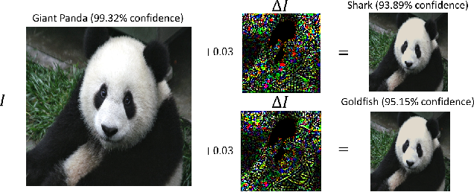
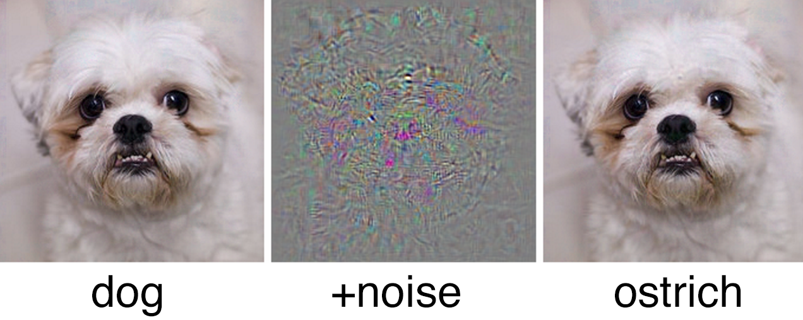
WHAT DO YOU SEE

Slide 7
ADVERSARIAL ATTACKS
The most common attack. It can be further classified into:
White-Box: Attackers know full knowledge about the Machine Learning algorithm, Machine Learning model, (i.e., parameters and hyperparameters), architecture, etc.
Black-Box: Attackers almost know nothing about the Machine Learning system (perhaps know number of features, Machine Learning algorithm).

Slide 8
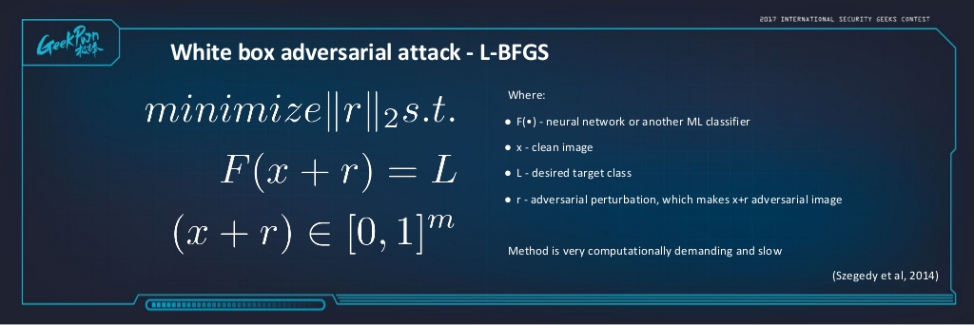
GENERATING ADVERSARIAL EXAMPLES
WHITE BOX ADVERSARIAL ATTACKS
L-BFGS (Szegedy et al,2014): Szegedy et al first demonstrated the existence of small perturbations to the images, such that the perturbed images could fool deep learning models into misclassification.

Slide 9
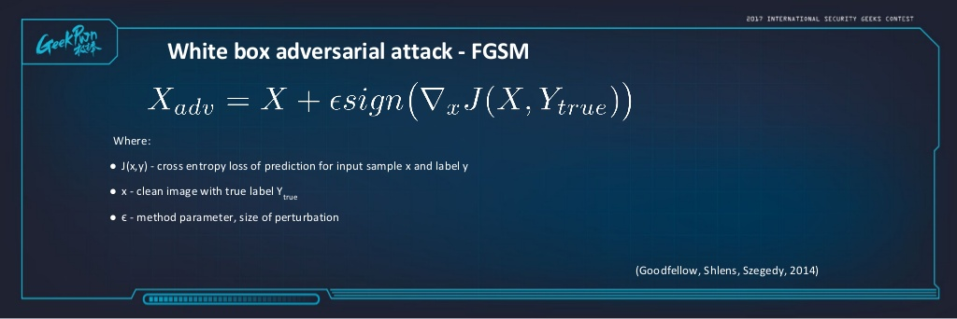
GENERATING ADVERSARIAL EXAMPLES
Fast Gradient Sign Method(FGSM): Goodfellow et al. proposed a fast method called Fast Gradient Sign Method to generate adversarial examples. They only performed one step gradient update along the direction of the sign of gradient at each pixel.

Slide 10
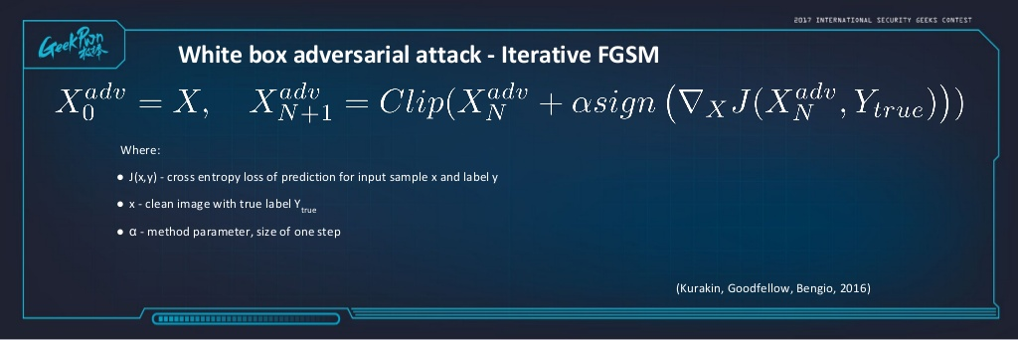
GENERATING ADVERSARIAL EXAMPLES
ITERATIVE FGSM: Extended Fast Gradient Sign method by running a finer optimization (smaller change) for multiple iterations.

Slide 11
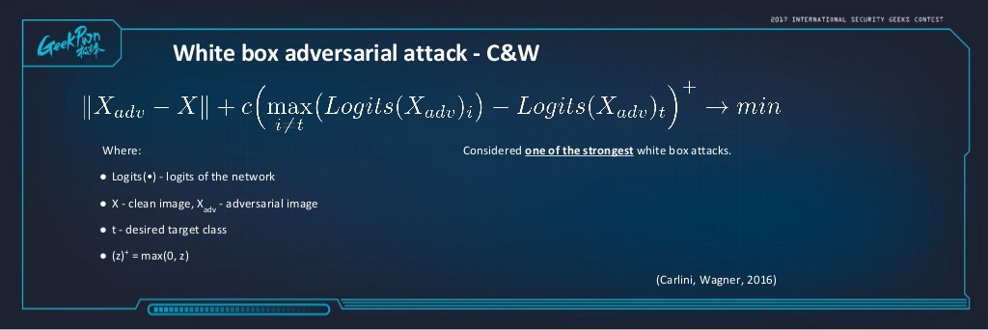
GENERATING ADVERSARIAL EXAMPLES
Carlini and Wagner Attacks

Slide 12
GENERATING ADVERSARIAL EXAMPLES
JACOBIAN BASED SALIENCY MAP ATTACK : Papernot et al. designed an efficient saliency adversarial map, called Jacobian-based Saliency Map Attack. A small perturbation was designed to successfully induce large output variations so that change in a small portion of features could fool the neural network.
DEEPFOOL: Moosavi-Dezfooli et al proposed to compute a minimal norm adversarial perturbation for a given image in an iterative manner. DeepFool initializes with the clean image that is assumed to reside in a region confined by the decision boundaries of the classifier.

Slide 13
BLACK BOX ATTACKS
Adversarial Sample Transferability
Cross model transferability: The same adversarial sample is often misclassified by a variety of classifiers with different architectures
cross training-set transferability: The same adversarial sample is often misclassified trained on different subsets of the training data.
Therefore, an attacker can
First train his own (white-box) substitute model
Then generate adversarial samples
Finally, apply the adversarial samples to the target ML model

Slide 14
DEFENSES AGAINST ADVERSARIAL ATTACKS
USING BRUTE-FORCE ADVERSARIAL TRAINING: Training with
adversarial examples is one of the countermeasures to make
neural networks more robust. Goodfellow et al and Huang et al
included adversarial examples in the training stage. They
generated adversarial examples in every step of training and
inject them into the training set. They showed that adversarial
training improved the robustness of deep neural networks.
Adversarial training could provide regularization for deep neural
networks and improve the precision as well.

Slide 15
DEFENSES AGAINST ADVERSARIAL ATTACKS
INPUT RECONSTRUCTION: Adversarial examples can be transformed to clean data through reconstruction. After transformation, the adversarial examples will not affect the prediction of deep learning models. Gu and Rigazio proposed a variant of autoencoder network with a penalty, called deep contractive autoencoder, to increase the robustness of neural networks. A denoising autoencoder network is trained to encode adversarial examples to original ones to remove adversarial perturbations.

Slide 16
DEFENSES AGAINST ADVERSARIAL ATTACKS
ADVERSARIAL DETECTION: Metzen et al. created a detector for adversarial examples as an auxiliary network of the original neural network. The detector is a small and straightforward neural network predicting on binary classification, i.e., the probability of the input being adversarial.
NETWORK VERIFICATION: Verifying properties of deep neural networks is a promising solution to defend adversarial examples, because it may detect the new unseen attacks. Network verification checks the properties of a neural network: whether an input violates or satisfies the property.

Slide 17
DEFENSES AGAINST ADVERSARIAL ATTACKS
ENSEMBLING DEFENSES: Due to the multi-facet of adversarial examples, multiple defense strategies can be performed together (parallel or sequential) to defend adversarial examples.

Slide 18
CONCLUSION
ML algorithms and methods are vulnerable to many types of attack.
Adversarial examples shows its transferability in ML models, i.e., either cross-models (inter or intra) or cross-training sets.
However, adversarial examples can be leveraged to improve the performance or the robustness of ML models.

Slide 19
THANK YOU

